Slide 1
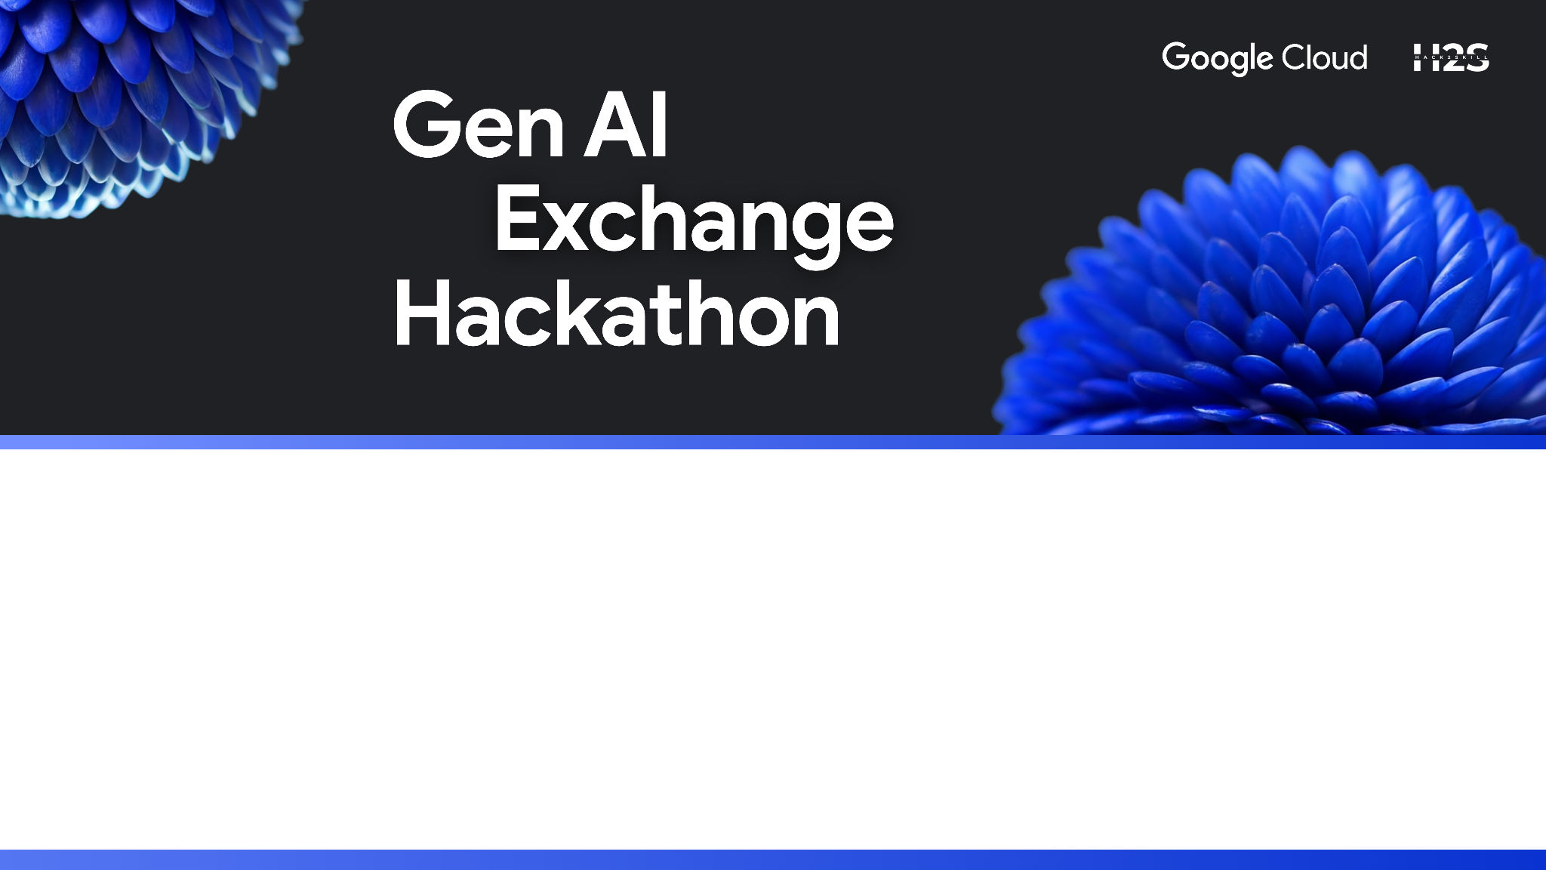
Team Name : ResolveAI
Team Leader Name : Maseera Irfan Ali Sayed
Problem Statement : AI-Powered Governance: Transforming Citizen Service Delivery

Slide 2

Brief about the prototype:
ResolveAI is a Dual-AI platform designed for Municipal Corporations (like MCGM) to triage unstructured citizen complaints and proactively predict infrastructure failure (like potholes and water leaks) across the 24 Mumbai Wards.
The solution uses a Machine Learning (ML) model to predict issue severity and Gemini (Generative AI) to analyze text, draft work orders, and enhance communication.
It moves governance from reactive (fixing what's broken) to proactive (fixing before it breaks).
Opportunity Explained:
Problem: Manual processing of citizen complaints is slow, leads to backlogs, and poor resource allocation, resulting in repeated failures (e.g., the same pothole reappears).
Opportunity: Implement an intelligent system to automate triage, predict hotspots, and instantly generate structured work orders for field staff.

Slide 3
Opportunity should be able to explain the following:
How different is it from any of the other existing solutions?
How will it be able to solve the problem?
USP of the proposed solution
Traditional Solution: Rely on manual input, basic ticket systems, and descriptive statistics (reports of past failures).
ResolveAI Difference: It fuses Predictive ML (identifying where and when problems are likely) with Generative AI (automating what to do about it). This Dual-AI system provides a unique end-to-end management capability.
Rapid Triage: Gemini instantly analyzes vague, unstructured citizen text (e.g., "The road near the temple is bad") and extracts key data (location, severity, type).
Proactive Planning: The ML model predicts high-risk areas based on historical data, road age, and mock precipitation data, allowing managers to dispatch crews before a complaint is even filed.
Automated Workflows: Gemini drafts detailed, structured work orders and communications, cutting down administrative time by over 70%.
Dual-AI Proactivity: Combining ML-driven prediction with GenAI-driven automation in a single, secure platform.
Mumbai-Local Focus: Model is trained and contextualized using data mapped specifically to the 24 MCGM Wards.

Slide 4
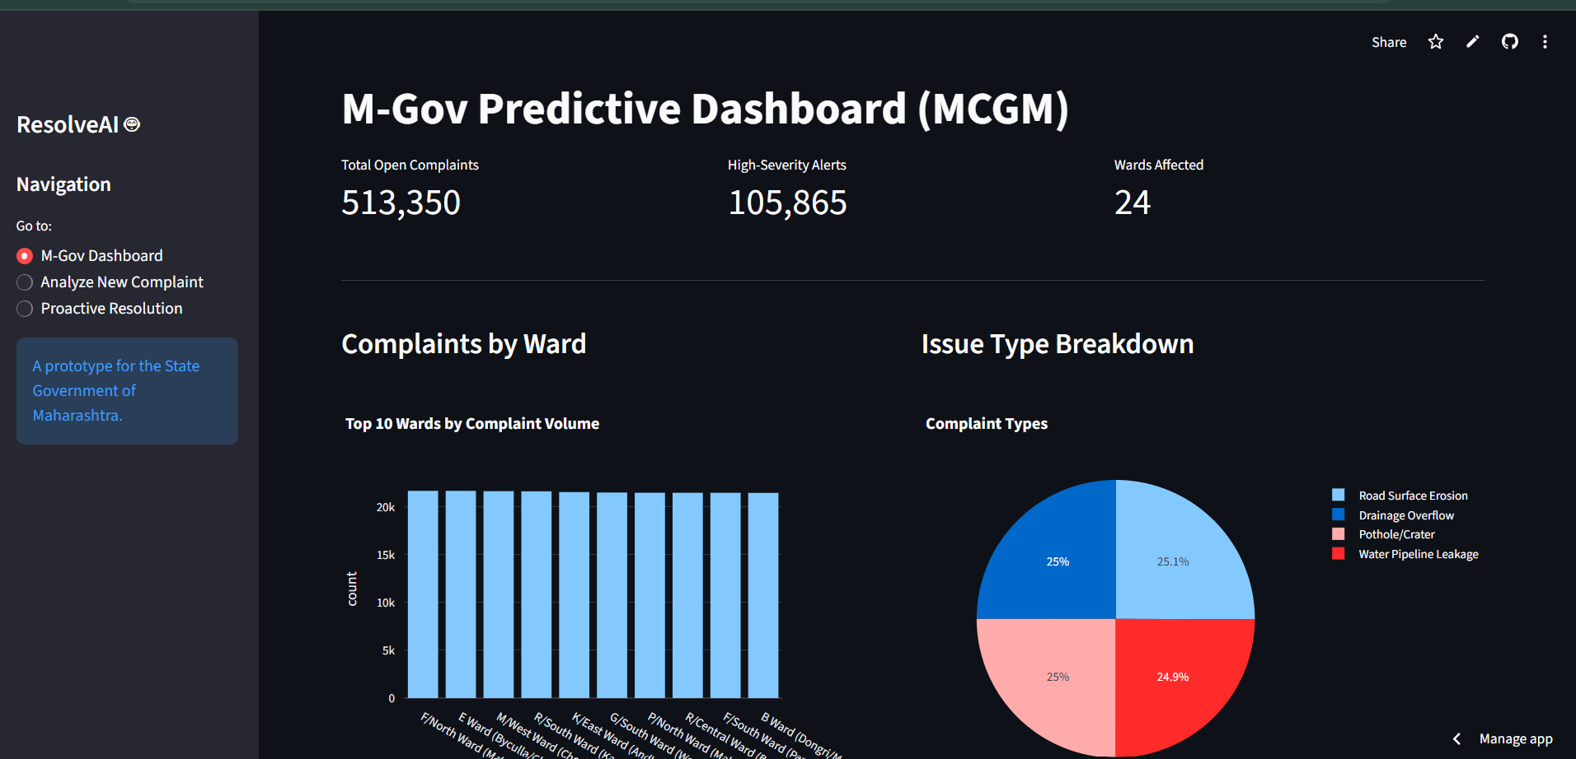
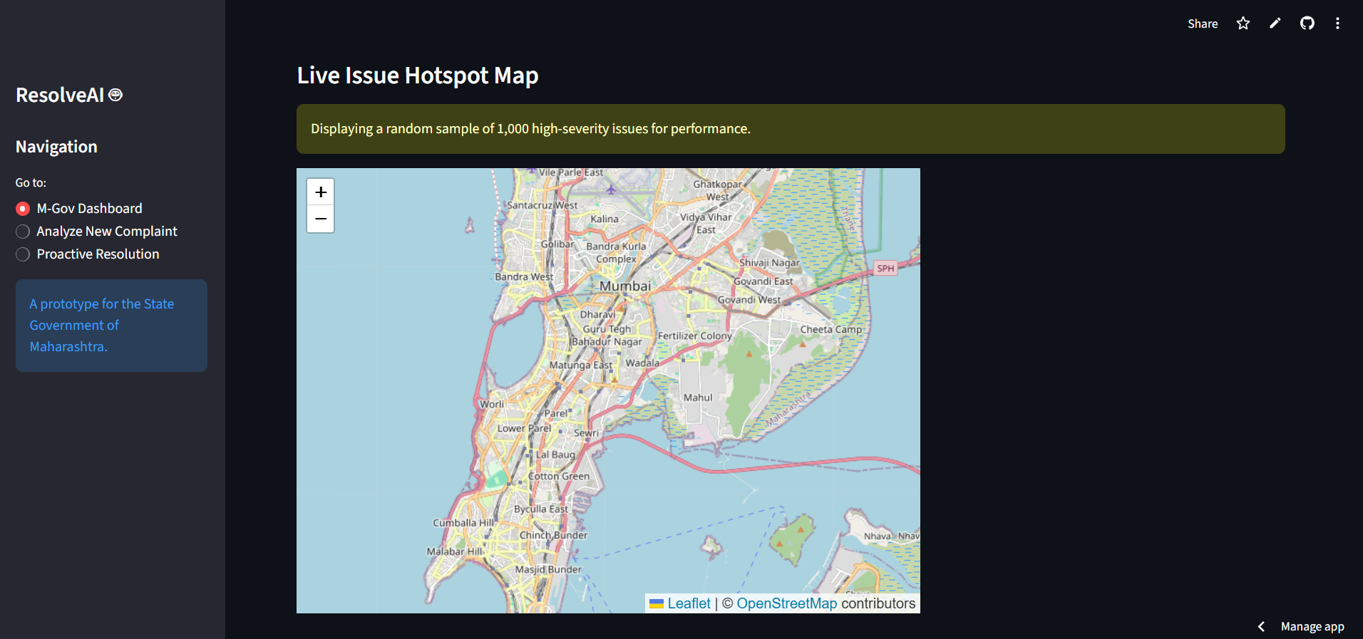
List of features offered by the solution:
Dashboard View: Live map of predicted high-severity potholes/leaks across all 24 Wards.
Triage/Analyze Page: Allows managers to paste raw text complaints for instant GenAI analysis (Severity, Ward, Issue Type extraction).
Predictive Work Order Generation: Generates a structured task list and draft response using Gemini, ready for manager approval.
Secure Access: Prototype features a secure login, demonstrating Role-Based Access Control (RBAC) readiness.
Localized Data Engine: Leverages large NYC 311 data, cleaned and localized to Mumbai context.

Slide 5
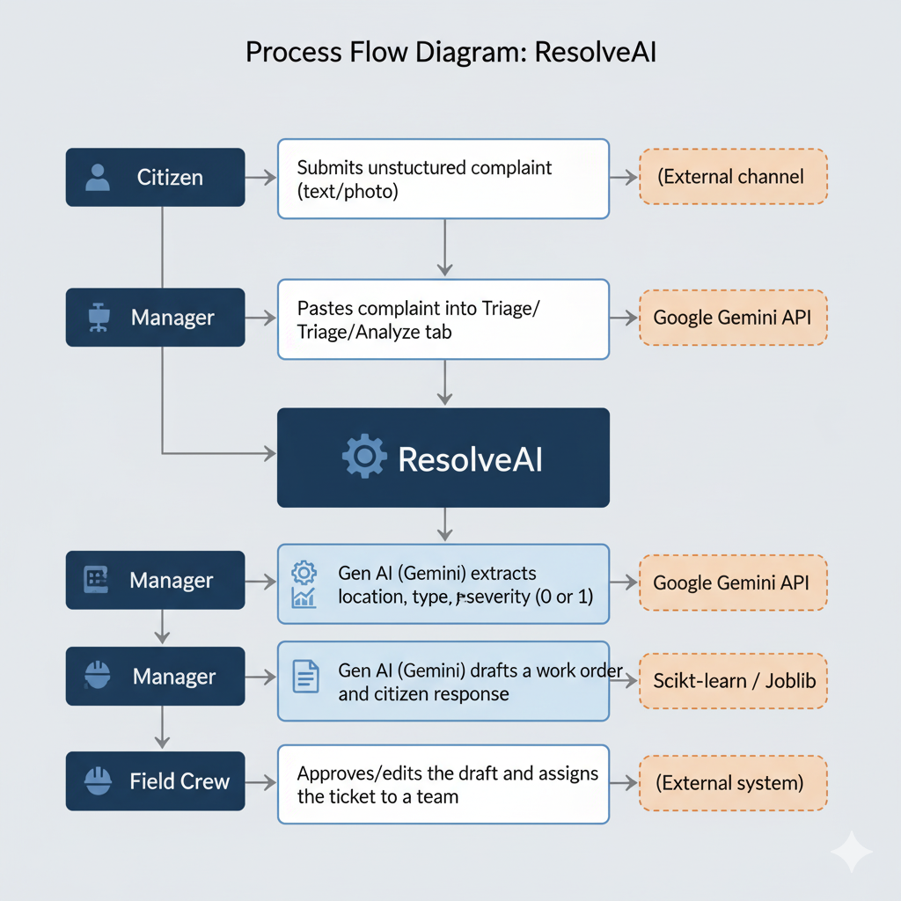
Process flow diagram:

Slide 6
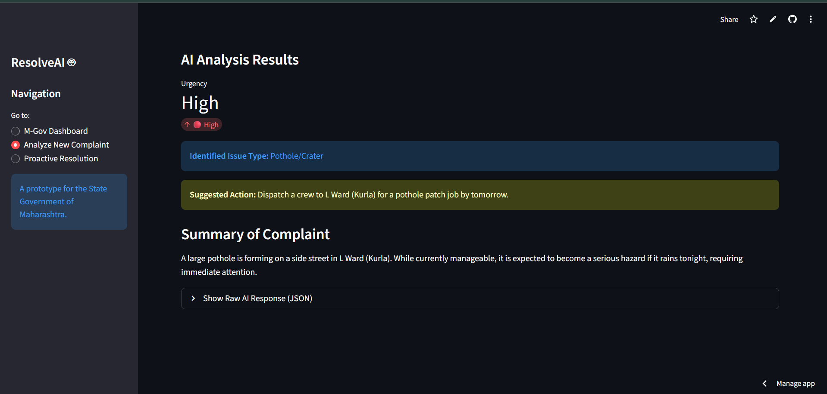
Mock diagrams of the proposed solution(Optional)

Slide 7
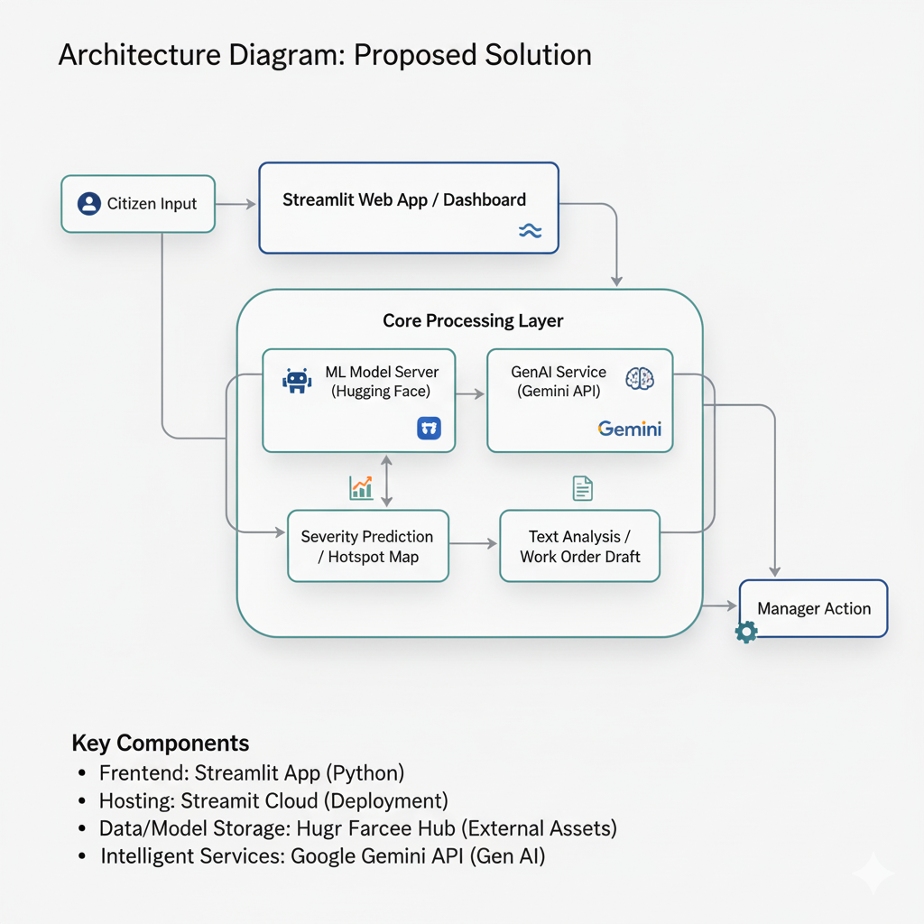
Architecture diagram of the proposed solution

Slide 8
Technologies to be used in the solution:
Category | Technology | Purpose
Generative AI | Google Gemini API | Core intelligence for text analysis and drafting work orders.
Machine Learning | Scikit-learn (RandomForest) | Predictive modeling for severity assessment and hotspot identification.
Frontend/App | Streamlit | Rapid application development and data visualization (Dashboard/UI).
Deployment/Hosting | Streamlit Cloud | Simple, fast, public deployment of the Python app.
Asset Storage | Hugging Face Hub | Bypassing the 100MB limit for the large ML model and simulated data.
Data Context | Pandas / Folium | Data manipulation, mapping, and localization of NYC data to Mumbai Wards.

Slide 9
Estimated implementation cost (optional):
Prototype Cost: $0 (Free Tier)
Streamlit Cloud: Free
Hugging Face Hub: Free
Gemini API: Utilized generous free-tier credits for development.
Production Cost (Annual Estimate for Mumbai City): $\approx \$15,000 - \$25,000$ (Low estimate, excluding personnel)
Major Cost Driver: Gemini API Usage (Cost per million tokens for high-volume analysis).
Minor Cost Driver: Managed Cloud Services (e.g., Google Cloud Storage/Vertex AI for scalable ML deployment).
ROI (Return on Investment): The cost is easily offset by the estimated 30% reduction in repeat infrastructure failures and the 70%-time savings in manual ticket processing.

Slide 10
Add as per the requirements for the hackathon:
Data Security & Privacy:
Secrets Management (Done): All API keys are managed securely via Streamlit Secrets (environment variables), not hard-coded or committed to GitHub.
Role-Based Access (RBAC): The prototype is built for a secure, internal government system requiring manager-level login (future implementation would enforce user roles).
Scalability:
Deployment: The Streamlit/Gemini architecture is highly scalable, requiring only resource allocation adjustments for the Gemini API to handle millions of requests.
ML Model: By using Hugging Face, the model file is versioned and easily loadable by multiple instances of the app.
Impact: Resolves the critical civic challenge of infrastructure decay by providing an Intelligent, Predictive, and Automated management tool.

Slide 11
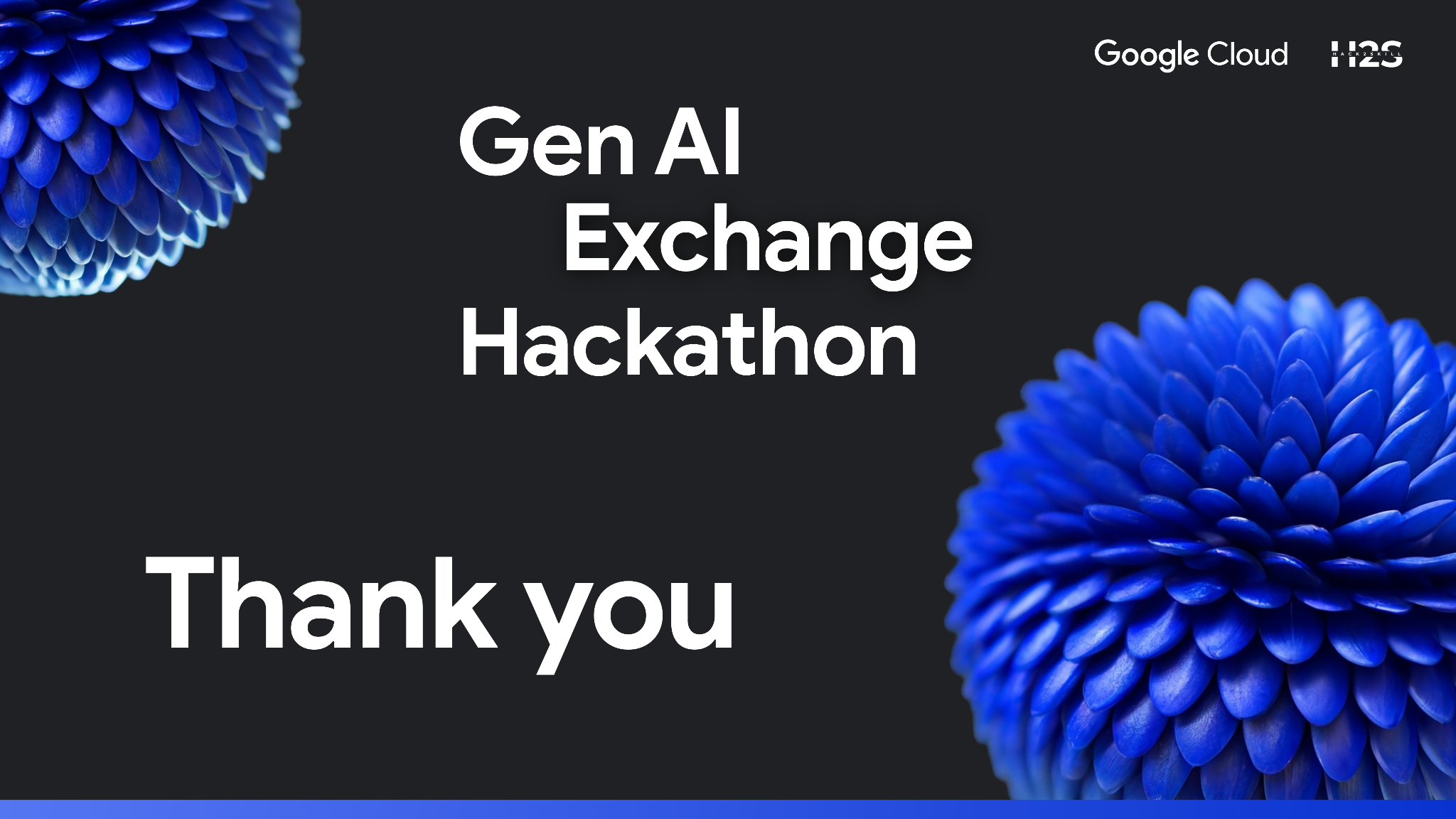
Working prototype Link: https://resolveai-hackathon-29ms.streamlit.app/
GitHub Repository: https://github.com/masira-syd29/ResolveAI-Hackathon

